Slide 1
Outline
Introduction
Background
Distributed Database Design
Database Integration
Semantic Data Control
Distributed Query Processing
Multidatabase Query Processing
Distributed Transaction Management
Data Replication
Parallel Database Systems
Data placement and query processing
Load balancing
Database clusters
Distributed Object DBMS
Peer-to-Peer Data Management
Web Data Management
Current Issues

Slide 2
The Database Problem
Large volume of data ⇒ use disk and large main memory
I/O bottleneck (or memory access bottleneck)
Speed(disk) << speed(RAM) << speed(microprocessor)
Predictions
Moore’s law: processor speed growth (with multicore): 50 % per year
DRAM capacity growth : 4 ⋅ every three years
Disk throughput : 2 ⋅ in the last ten years
Conclusion : the I/O bottleneck worsens

Slide 3
The Solution
Increase the I/O bandwidth
Data partitioning
Parallel data access
Origins (1980's): database machines
Hardware-oriented ⇒ bad cost-performance ⇒ failure
Notable exception : ICL's CAFS Intelligent Search Processor
1990's: same solution but using standard hardware components integrated in a multiprocessor
Software-oriented
Standard essential to exploit continuing technology improvements

Slide 4
Multiprocessor Objectives
High-performance with better cost-performance than mainframe or vector supercomputer
Use many nodes, each with good cost-performance, communicating through network
Good cost via high-volume components
Good performance via bandwidth
Trends
Microprocessor and memory (DRAM): off-the-shelf
Network (multiprocessor edge): custom
The real chalenge is to parallelize applications to run with good load balancing

Slide 5
Data Server Architecture
Client
client interface
Application
server
query parsing
data server interface
communication channel
Data
server
application server interface
database functions
database

Slide 6
Objectives of Data Servers
Avoid the shortcomings of the traditional DBMS approach
Centralization of data and application management
General-purpose OS (not DB-oriented)
By separating the functions between
Application server (or host computer)
Data server (or database computer or back-end computer)

Slide 7
Data Server Approach: Assessment
Advantages
Integrated data control by the server (black box)
Increased performance by dedicated system
Can better exploit parallelism
Fits well in distributed environments
Potential problems
Communication overhead between application and data server
High-level interface
High cost with mainframe servers

Slide 8
Parallel Data Processing
Three ways of exploiting high-performance multiprocessor systems:
Automatically detect parallelism in sequential programs (e.g., Fortran, OPS5)
Augment an existing language with parallel constructs (e.g., C*, Fortran90)
Offer a new language in which parallelism can be expressed or automatically inferred
Critique
Hard to develop parallelizing compilers, limited resulting speed-up
Enables the programmer to express parallel computations but too low-level
Can combine the advantages of both (1) and (2)

Slide 9
Data-based Parallelism
Inter-operation
p operations of the same query in parallel
op.3
op.1
op.2
Intra-operation
The same op in parallel
op.
op.
op.
op.
op.
R
R₁
R₂
R₃
R₄

Slide 10
Parallel DBMS
Loose definition: a DBMS implemented on a tighly coupled multiprocessor
Alternative extremes
Straighforward porting of relational DBMS (the software vendor edge)
New hardware/software combination (the computer manufacturer edge)
Naturally extends to distributed databases with one server per site

Slide 11
Parallel DBMS - Objectives
Much better cost / performance than mainframe solution
High-performance through parallelism
High throughput with inter-query parallelism
Low response time with intra-operation parallelism
High availability and reliability by exploiting data replication
Extensibility with the ideal goals
Linear speed-up
Linear scale-up

Slide 12
Linear Speed-up
Linear increase in performance for a constant DB size and proportional increase of the system components (processor, memory, disk)
ideal
new perf.
old perf.
components

Slide 13
Linear Scale-up
Sustained performance for a linear increase of database size and proportional increase of the system components.
new perf.
ideal
old perf.
components + database size

Slide 14
Barriers to Parallelism
Startup
The time needed to start a parallel operation may dominate the actual computation time
Interference
When accessing shared resources, each new process slows down the others (hot spot problem)
Skew
The response time of a set of parallel processes is the time of the slowest one
Parallel data management techniques intend to overcome these barriers

Slide 15
Parallel DBMS – Functional Architecture
User
task 1
User
task n
Session Mgr
RM
task 1
Request Mgr
RM
task n
DM
task 11
DM
task 12
Data Mgr
DM
task n2
DM
task n1

Slide 16
Parallel DBMS Functions
Session manager
Host interface
Transaction monitoring for OLTP
Request manager
Compilation and optimization
Data directory management
Semantic data control
Execution control
Data manager
Execution of DB operations
Transaction management support
Data management

Slide 17
Parallel System Architectures
Multiprocessor architecture alternatives
Shared memory (SM)
Shared disk (SD)
Shared nothing (SN)
Hybrid architectures
Non-Uniform Memory Architecture (NUMA)
Cluster

Slide 18
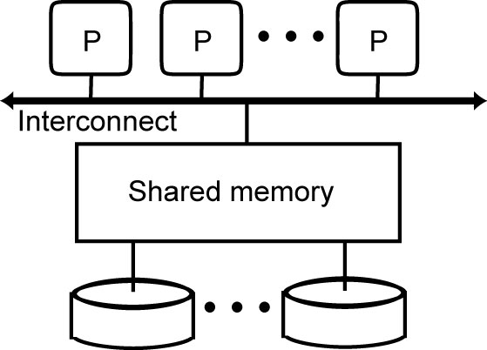
Shared-Memory
DBMS on symmetric multiprocessors (SMP)
Prototypes: XPRS, Volcano, DBS3
+ Simplicity, load balancing, fast communication
- Network cost, low extensibility

Slide 19
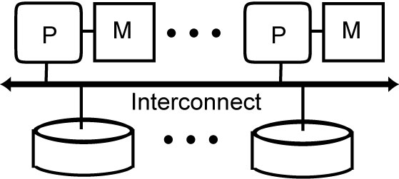
Shared-Disk
Origins : DEC's VAXcluster, IBM's IMS/VS Data Sharing
Used first by Oracle with its Distributed Lock Manager
Now used by most DBMS vendors
+ network cost, extensibility, migration from uniprocessor
- complexity, potential performance problem for cache coherency

Slide 20
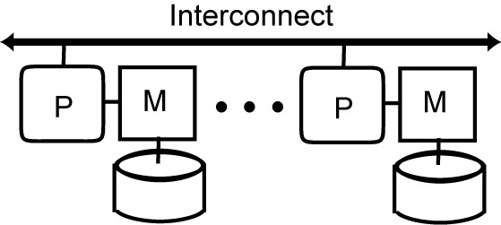
Shared-Nothing
Used by Teradata, IBM, Sybase, Microsoft for OLAP
Prototypes: Gamma, Bubba, Grace, Prisma, EDS
+ Extensibility, availability
- Complexity, difficult load balancing

Slide 21
Hybrid Architectures
Various possible combinations of the three basic architectures are possible to obtain different trade-offs between cost, performance, extensibility, availability, etc.
Hybrid architectures try to obtain the advantages of different architectures:
efficiency and simplicity of shared-memory
extensibility and cost of either shared disk or shared nothing
2 main kinds: NUMA and cluster

Slide 22
NUMA
Shared-Memory vs. Distributed Memory
Mixes two different aspects : addressing and memory
Addressing: single address space vs multiple address spaces
Physical memory: central vs distributed
NUMA = single address space on distributed physical memory
Eases application portability
Extensibility
The most successful NUMA is Cache Coherent NUMA (CC-NUMA)

Slide 23
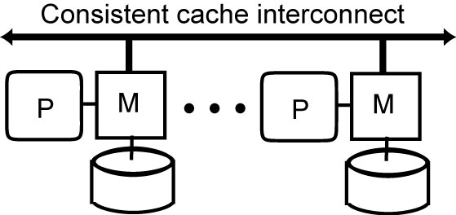
CC-NUMA
Principle
Main memory distributed as with shared-nothing
However, any processor has access to all other processors’ memories
Similar to shared-disk, different processors can access the same data in a conflicting update mode, so global cache consistency protocols are needed.
Cache consistency done in hardware through a special consistent cache interconnect
Remote memory access very efficient, only a few times (typically between 2 and 3 times) the cost of local access

Slide 24
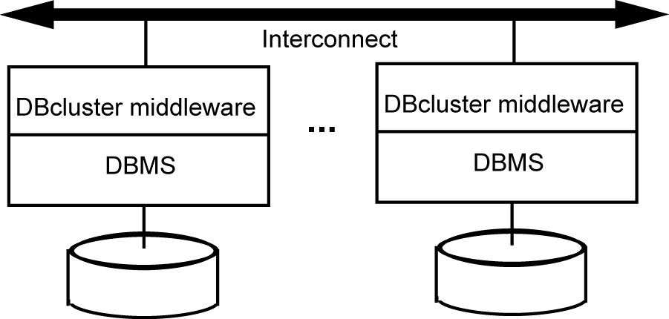
Cluster
Combines good load balancing of SM with extensibility of SN
Server nodes: off-the-shelf components
From simple PC components to more powerful SMP
Yields the best cost/performance ratio
In its cheapest form,
Fast standard interconnect (e.g., Myrinet and Infiniband) with high bandwidth (Gigabits/sec) and low latency

Slide 25
SN cluster vs SD cluster
SN cluster can yield best cost/performance and extensibility
But adding or replacing cluster nodes requires disk and data reorganization
SD cluster avoids such reorganization but requires disks to be globally accessible by the cluster nodes
Network-attached storage (NAS)
distributed file system protocol such as NFS, relatively slow and not appropriate for database management
Storage-area network (SAN)
Block-based protocol thus making it easier to manage cache consistency, efficient, but costlier

Slide 26
Discussion
For a small configuration (e.g., 8 processors), SM can provide the highest performance because of better load balancing
Some years ago, SN was the only choice for high-end systems. But SAN makes SN a viable alternative with the main advantage of simplicity (for transaction management)
SD is now the preferred architecture for OLTP
But for OLAP databases that are typically very large and mostly read-only, SN is used
Hybrid architectures, such as NUMA and cluster, can combine the efficiency and simplicity of SM and the extensibility and cost of either SD or SN

Slide 27
Parallel DBMS Techniques
Data placement
Physical placement of the DB onto multiple nodes
Static vs. Dynamic
Parallel data processing
Select is easy
Join (and all other non-select operations) is more difficult
Parallel query optimization
Choice of the best parallel execution plans
Automatic parallelization of the queries and load balancing
Transaction management
Similar to distributed transaction management

Slide 28
Data Partitioning
Each relation is divided in n partitions (subrelations), where n is a function of relation size and access frequency
Implementation
Round-robin
Maps i-th element to node i mod n
Simple but only exact-match queries
B-tree index
Supports range queries but large index
Hash function
Only exact-match queries but small index

Slide 29
Partitioning Schemes
•••
•••
•••
•••
•••
Round-Robin
Hashing
•••
a-g
h-m
•••
u-z
Interval

Slide 30
Replicated Data Partitioning
High-availability requires data replication
simple solution is mirrored disks
hurts load balancing when one node fails
more elaborate solutions achieve load balancing
interleaved partitioning (Teradata)
chained partitioning (Gamma)

Slide 31
Interleaved Partitioning
Node
1
2
3
4
Primary copy R₁ R₂ R₃ R₄
Backup copy r_{1.1} r_{1.2} r_{1.3}
r_{2.3} r_{2.1} r_{2.2}
r_{3.2} r_{3.2} r_{3.1}

Slide 32
Chained Partitioning
Node
1
2
3
4
Primary copy R₁ R₂ R₃ R₄
Backup copy r₄ r₁ r₂ r₃

Slide 33
Placement Directory
Performs two functions
F₁ (relname, placement attval) = lognode-id
F₂ (lognode-id) = phynode-id
In either case, the data structure for f₁ and f₂ should be available when needed at each node

Slide 34
Join Processing
Three basic algorithms for intra-operator parallelism
Parallel nested loop join: no special assumption
Parallel associative join: one relation is declustered on join attribute and equi-join
Parallel hash join: equi-join
They also apply to other complex operators such as duplicate elimination, union, intersection, etc. with minor adaptation

Slide 35

Parallel Nested Loop Join
node 1
node 2
R₁:
R₂:
send
partition
S₁
S₂
node 3
node 4

Slide 36
Parallel Associative Join
node 1
node 2
R₁:
R₂:
S₁
S₂
node 3
node 4

Slide 37
Parallel Hash Join
node
node
node
node
R₁:
R₂:
S₁:
S₂:
node 1
node 2

Slide 38
Parallel Query Optimization
The objective is to select the “best” parallel execution plan for a query using the following components
Search space
Models alternative execution plans as operator trees
Left-deep vs. Right-deep vs. Bushy trees
Search strategy
Dynamic programming for small search space
Randomized for large search space
Cost model (abstraction of execution system)
Physical schema info. (partitioning, indexes, etc.)
Statistics and cost functions

Slide 39
Execution Plans as Operator Trees
Result
Result
j3
j6
Left-deep
j2
R4
R4
j5
Right-deep
j1
R3
R3
j4
R1
R2
R1
R2
Result
Result
j9
R4
j12
Bushy
Zig-zag
j8
j10
j11
j7
R3
R1
R2
R3
R4
R1
R2

Slide 40
Equivalent Hash-Join Trees with Different Scheduling
Build3
Probe3
Build3
Probe3
Build3
Temp2
Temp2
R4
R4
Build2
Probe2
Build2
Probe2
Temp1
Temp1
R3
R3
Build1
Probe1
Build1
Probe1
R1
R2
R1
R2

Slide 41
Load Balancing
Problems arise for intra-operator parallelism with skewed data distributions
attribute data skew (AVS)
tuple placement skew (TPS)
selectivity skew (SS)
redistribution skew (RS)
join product skew (JPS)
Solutions
sophisticated parallel algorithms that deal with skew
dynamic processor allocation (at execution time)

Slide 42
Data Skew Example
JPS
JPS
Res1
Res2
AVS/TPS
Join1
Join2
AVS/TPS
S2
S1
RS/SS
RS/SS
AVS/TPS
Scan1
Scan2
AVS/TPS
R2
R1

Slide 43
Load Balancing in a DB Cluster
Q₄
Q₃
Q₂
Q₁
Choose the node to execute Q
round robin
The least loaded
Need to get load information
Fail over
In case a node N fails, N’s queries are taken over by another node
Requires a copy of N’s data or SD
In case of interference
Data of an overloaded node are replicated to another node
Load balancing
Q₁
Q₂
Q₃
Q₄

Slide 44
Oracle Transparent Application Failover
Client
Node 1
Ping
Node 2
connect1
Notes:
Animated slide

Slide 45


Microsoft Failover Cluster Topology
Client PCs
Enterprise network
Internal network
Fibre Channel

Slide 46
Main Products
Vendor | Product | Architecture | Platforms
IBM | DB2 Pure Scale DB2 Database Partitioning Feature (DPF) | SD SN | AIX on SP Linux on cluster
Microsoft | SQL Server SQL Server 2008 R2 Parallel Data Warehouse | SD SN | Windows on SMP and cluster
Oracle | Real Application Cluster Exadata Database Machine | SD | Windows, Unix, Linux on SMP and cluster
NCR | Teradata | SN Bynet network | NCR Unix and Windows
Oracle | MySQL | SN | Linux Cluster

Slide 47
The Exadata Database Machine
New machine from Oracle with Sun
Objectives
OLTP, OLAP, mixed workloads
Oracle Real Application Cluster
8+ servers bi-pro Xeon, 72 GB RAM
Exadata storage server : intelligent cache
14+ cells, each with
2 processors, 24 Go RAM
385 GB of Flash memory (read is 10* faster than disk)
12+ SATA disks of 2 To or 12 SAS disks of 600 GB

Slide 48
Exadata Architecture
Real Application Cluster
Infiniband Switches
Storage cells

